Slide 1
Structuring Machine Learning Projects
Deep Learning Specialization Report
Toshiba Software Development (Vietnam) Co., Ltd.
2021-10-19

Slide 2
Contents
01
Introduction to ML Strategy
02
Comparing to Human-level Performance
03
Error Analysis
04
Mismatched Training & Dev/Test Set
05
Learning from Multiple Tasks & End-to-end deep learning

Slide 3
Introduction to Machine Learning Strategy
01

Slide 4
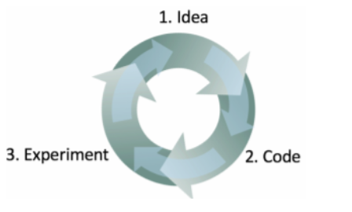
1.1 Introduction to ML Strategy: Why ML Strategy
A lot of ideas to improve the accuracy of ML model:
Collect more data, diverse training set.
Train algorithm longer with gradient descent.
Try bigger/smaller network.
Change network architecture (activation functions, # of hidden units, etc ..)
This course will give some strategies to help analyze the machine learning problem to go in a direction that will help you get better results.

Slide 5
1.1 Introduction to ML Strategy: Orthogonalization
Orthogonalization: the process tune hyperparameters in order to try to achieve effect.
Each control does a specific task & doesn’t affect other controls.
Chain of assumptions in Machine Learning:
Fit training set well on cost function.
If model not achieved, try bigger network, another optimization algorithms …
Fit dev set well on cost function.
If model not achieved, try bigger training set, regularization …
Fit test set well on cost function.
If model not achieved, try bigger dev set …
Performs well in real worlds.
If model not achieved, try change dev set, change cost function …

Slide 6
1.2 Setting Up your Goal: Single Number Evaluation Metric
Before starting on a machine learning project, we need set up a single real number evaluation metric for model. The metric allow you to easily & quickly judge if a certain change improved performance.
Consider an example cat recognition:
Precision: what percentage actually are cats ?
Recall: what percentage of actually cats are correctly recognized by model ?
F1-Score: “average” of precision & recall (Harmonic mean).
Notes:
Traid-off precision & recall ?

Slide 7
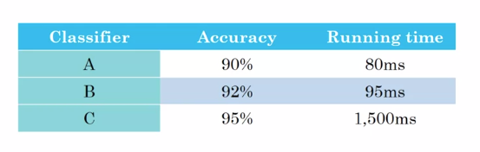
1.3 Satisficing and Optimizing Metric
Consider cat classification example:
Solve: choosing a single optimizing metric & decide that other metrics are satisfying.
Notes:
Traid-off precision & recall ?

Slide 8
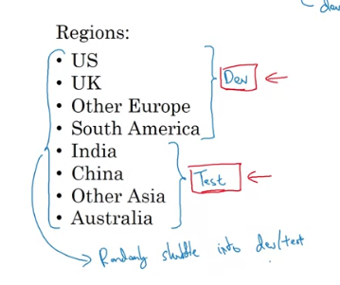
1.4 Train/Dev/Test distributions
Consider a cat classification example:
Guideline:
Dev & test sets have to come from the same distribution.
Choose dev & test sets to reflect data you expect to get in the future & consider important to do well on.
Setting up the dev set as well as the validation metric is really defining what target you want to aim at.
Notes:
Traid-off precision & recall ?

Slide 9
1.5 Size of the Dev & Test sets
Old way of splitting data (dataset sizes ~ 100000 examples):
Train/test: 70% - 30% or train/dev/test: 60% - 30% - 10%.
In the model deep learning, if dataset sizes > 1000000 examples:
Train/dev/test: 98% - 1% - 1%.
Guideline:
Set test set to be big enough to give high confidence in the overall performance of your system.
Notes:
Traid-off precision & recall ?

Slide 10
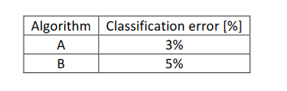


1.6 When to Change Dev/Test Sets & Metrics ?
Consider an example: Cat or Non-cat
Assumption, algorithm A performs better by original evaluation metric but showing users pornographic images.
The misclassification error metric:
Change evaluation metric by add the weight term w^{(i)} :
Break machine learning problem into distinct steps:
Step 1: Figure out how to define a metric that captures what you want to do - place the target.
Step 2: How to actually do well on this metric - how to aim/shoot accurately at the target.
Conclusion:
If doing well on metric & dev/test set doesn’t correspond to doing well in application, change metric & dev/test set.
Notes:
Traid-off precision & recall ?

Slide 11
Comparing to Human-level Performance
02

Slide 12
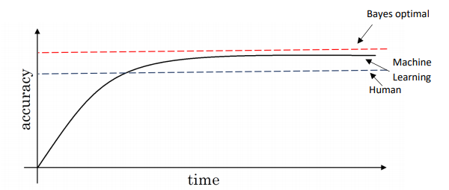
2.1 Why Human-level Performance ?
Comparing the ML systems to human level performance:
The ML algorithms are more productive & feasible in a lot of application.
The workflow of designing & building a ML system is efficient that before.
The graph show the performance of humans & machine learning over time:
When the performance of ML is worse than the performance of humans, you can try:
Get labeled data from humans
Gain insight from manual error analysis: Why did a person get this right ?
Better analysis of bias/variance.
Notes:
Traid-off precision & recall ?

Slide 13
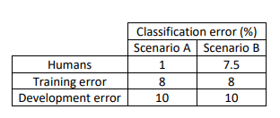
2.2 Avoidable Bias
The human-level performance is possible to tell when a training set is performing well or not.
Propose a cat classification example:
The human level error as a proxy for Bayer error since humans are good to identify images.
In the left example, we focus on the bias.
In the right example, we focus on the variance.
The avoidable bias: the difference between the training set & the human level error.
Remain:
Bias reduction technique:
Training a bigger neural network.
Running the training set longer.
Variance reduction technique:
Regularization
Try a bigger training set.
Notes:
Traid-off precision & recall ?

Slide 14
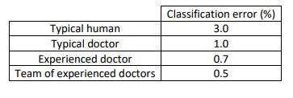
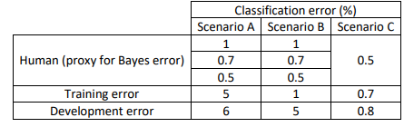
2.3 Understanding Human-level Performance
Human-level error gives an estimate of Bayes error.
Example 1. Medical image classification:
The definition of human-level error depends on the purpose of the analysis.
The bayes error is lower or equal to 0.5%.
Example 2. Error analysis {human-level performance, the avoidable bias & the variance}:
Scenario A: high bias.
Scenario B: high variance.
Scenario C: high bias.
Summary of bias/variance with human-level performance:
Human-level error: proxy for Bayers error.
If | human_level_error - training_error | > | training_error - dev_error|: the focus should be on bias reduction technique.
If | human_level_error - training_error | < | training_error - dev_error|: the focus should be on variance reduction technique.
Notes:
Traid-off precision & recall ?

Slide 15
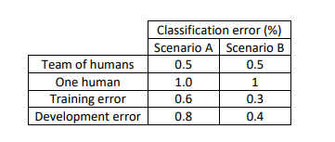
2.4 Surpassing human level performance
Consider an example - classification task:
Scenario B: Not enough information to know that model high bias or high variance.
There are many problems where machine learning significantly surpasses human level performance:
Online advertising
Product recommendations
Loan approvals
Notes:
Traid-off precision & recall ?

Slide 16
2.5 Improving model performance
The two fundamental assumptions of supervised learning:
With a low avoidable bias which means that the training set fits well.
With a low or acceptable variance which means that the training set performance generalizes well to the development set & test set.
To improve deep learning supervised system:
Look at the difference between human level error & the training error – avoidable bias.
If avoidable bias is large:
Train bigger model
Train longer/better optimization algorithms
Find better NN architecture/hyperparameters.
Look at the difference between the dev/test set & training set error – variance.
Get more training data
Regularization techniques
Find better NN architecture/hyperparameters.
Notes:
Traid-off precision & recall ?

Slide 17
Error Analysis
03

Slide 18
3.1 Carrying out error analysis
Error analysis: the process of manually examining mistakes that your algorithm is making.
Consider an example cat image classifier.
Obtain 10% error on test set.
The misclassified examples are pictures of dogs.
Should you try to make model cat classifier do better on dogs ?
Error analysis:
Get 100 mislabeled dev set examples at random.
Count up how many are dogs.
Evaluate multiple ideas in parallel:
Fix pictures of dogs being recognized as cats
Fix great cats being misrecognized
Improve performance of blurry image.
Summary:
When carrying out error analysis, should find a set of mislabeled examples & look at these examples for false positives & false negatives.
Notes:
Traid-off precision & recall ?

Slide 19
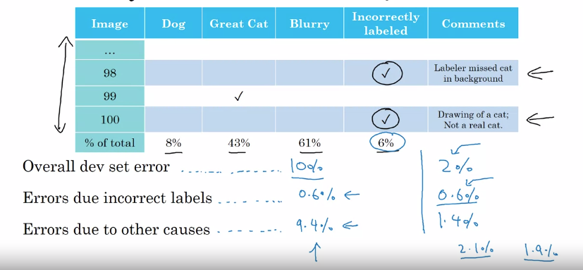
3.2 Cleaning up Incorrectly Labeled Data
DL algorithms are quite robust to random errors in the training set.
Check mislabeled data in dev/test set, you should try error analysis with the mislabeled column.
Consider these guidelines while correcting the dev/test mislabeled examples:
Apply the same process to dev & test sets to make sure they continue to come from the same distribution.
Consider examining examples your algorithm got right as well as ones it got wrong
Train & dev/test data may come from a slightly different distributions.
It’s very important to have dev & test sets to come from the same distribution. But it could be ok for train set to come from slightly other distribution.
Notes:
Traid-off precision & recall ?

Slide 20
3.3 Build your First System Quickly, then Iterate
The steps you take to make deep learning project:
Setup dev/test set & metric.
Build initial system quickly
Use bias/variance analysis & error analysis to prioritize next steps.
Notes:
Traid-off precision & recall ?

Slide 21
Mismatched Training & Dev/Test Set
04

Slide 22
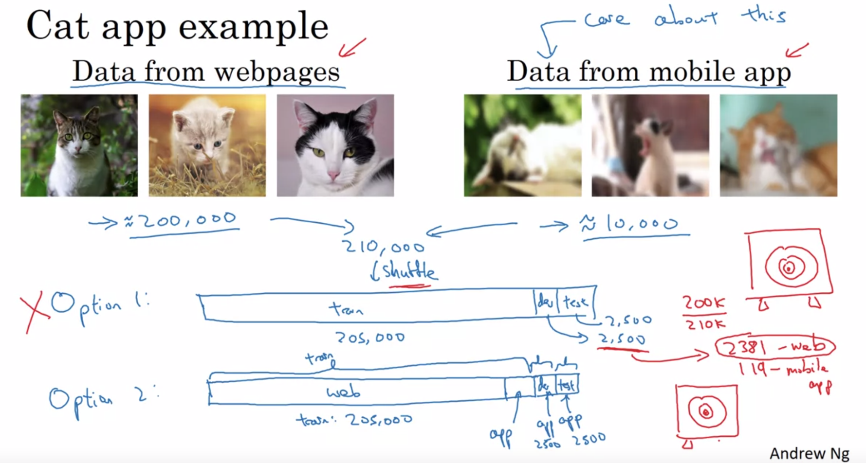
4.1 Training & Testing on Different Distributions
Consider an example:
Two strategies when training set distribution differs from dev/test sets distribution:
First strategy: shuffle all the data together & extract randomly training & dev/test sets.
Advantages: all the sets now come from the same distribution.
Disadvantages: the other distribution that was in the dev/test sets will occur less in the new dev/test sets & that might be not what you want to achieve.
Second strategy: take some of the dev/test set examples & add them to the training set:
Advantages: the distribution you care about is your target now.
Disadvantages: the distribution in training & dev/test sets are now different. However, the model will get a better performance over a long time.
Notes:
Traid-off precision & recall ?

Slide 23
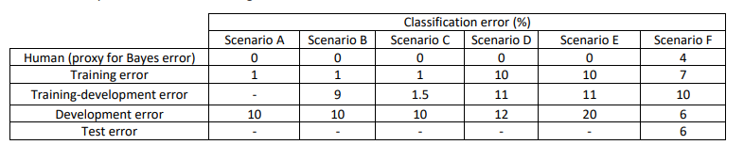
4.2 Bias & Variance with Mismatched Data Distributions
Consider an example: cat classifier with mismatch data distribution.
Conclusions:
Human-level error (proxy for Bayer error)
Train error:
calculate: avoidable_bias = training_error - human_level_error
If avoidable_bias big -> high bias
Train-dev error:
calculate: variance = training_dev_error - training_error. If variance big => high variance.
Dev error:
calculate: data_mismatch = dev_error - train_dev_error. If data_mismatch big => data mismatch problem
Test error:
calculate: degree_of_overfitting_to_dev_set = test_error - dev_error
If the different is big (positive) then maybe you need fine a bigger dev test.
Notes:
Traid-off precision & recall ?

Slide 24
4.3 Addressing data mismatch
The general guideline to address data mismatch:
Perform manual error analysis to understand the error differences between training & dev/test sets.
Make training data or collect data similar to development & test sets.
To make the training data more similar to dev set, you can use an artificial data synthesis.
Combine some of training data with something that can convert it to the dev/test set distribution.
Notes:
Traid-off precision & recall ?

Slide 25
Learning from Multiple Tasks
05

Slide 26
5.1 Transfer Learning
Transfer learning refers to using the neural network knowledge for another application.
When to use transfer learning:
Task A & B have the same input x.
A lot more data for task A than task B.
Low level feature from task A could be helpful for task B.
To do transfer learning, delete the last layer of NN & it’s weights and:
Option 1 : If you have a small dataset - keep all the other weights as a fixed weights. Add a new last layer & initialize the new layer weights & feed the new data to the NN & learn the new weights.
Option 2: If you have enough data you can retrain all the weights.
Notes:
Traid-off precision & recall ?

Slide 27
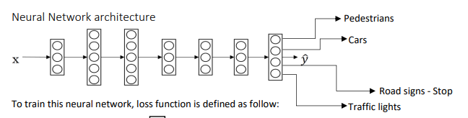

5.2 Multi-task learning
Multi-task learning refers to having one neural network do simultaneously several tasks.
When to use multi-task learning:
Training on a set of tasks that could benefit from having shared lower-level features.
Usually: amount of data you have for each task is quite similar.
Can train a big enough neural network to do well on all tasks.
Consider an example:
Build an object recognition system that detects pedestrians, cars, stop signs & traffic lights.
Y shape: (4, m) because 4 classes & each one is a binary one.
Neural network architecture:
Loss function:
End-to-end deep learning is the simplification of a processing or learning systems into one neural network.
Notes:
Traid-off precision & recall ?

Slide 28
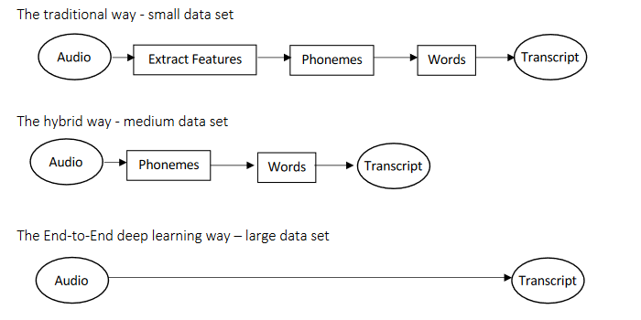
5.3 End-to-end deep leaning
Example – speech recognition model:
End-to-end deep learning is the simplification of a processing or learning systems into one neural network, removing the need to build many hand-designed individual components.
Notes:
Traid-off precision & recall ?

Slide 29
5.4 Whether or not to use end-to-end learning
Pros of end to end deep learning:
Let the data speak
Less hand designing of components needed.
Cons of end to end deep learning:
May need large amount of data
Excludes potentially useful hand design components.
Applying end to end deep learning:
Do you have sufficient data to learn a function of the complexity needed to map x to y ?
Notes:
Traid-off precision & recall ?

Slide 30
Thank you

